Slide 1


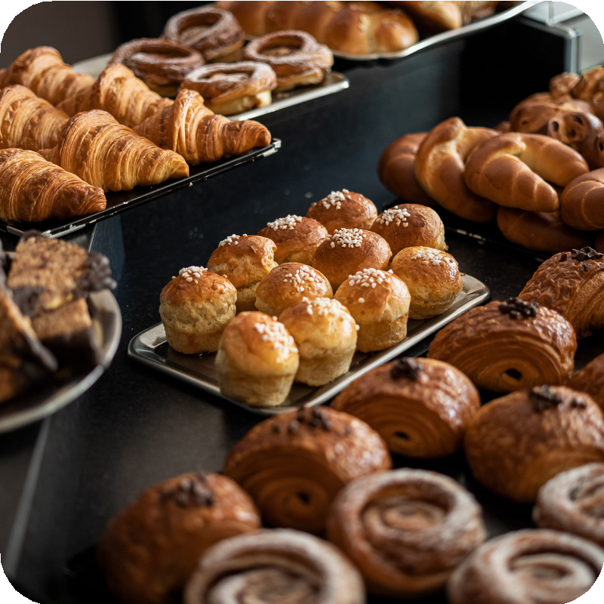
BlissFull Bites
N a m e : J a i v a l D a l a l R o l l N o : 0 3
E n r o l l m e n t N o : 2 3 0 0 2 1 7 0 1 2 0 0 0 6 B a t c h : D 1 B r a n c h : C E
N a m e : S h a h D h r u v a J i g n e s h R o l l N o : 0 8
E n r o l l m e n t N o : 2 3 0 0 2 1 7 0 1 2 0 0 1 7 B a t c h : D 1 B r a n c h : C E
N a m e : A h i r D h r u v R o l l N o : 2 5
E n r o l l m e n t N o : 2 3 0 0 2 1 7 0 1 2 0 0 0 2 B a t c h : D 1 B r a n c h : C E
N a m e : K r i n a l B e l a d i y a R o l l N o : 2 6
E n r o l l m e n t N o : 2 3 0 0 2 1 7 0 2 2 0 0 0 1 B a t c h : D 1 B r a n c h : I T

Slide 2


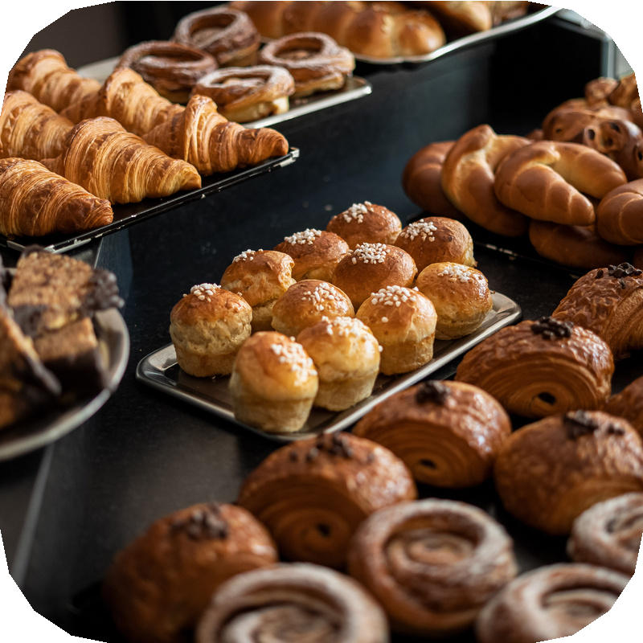
Project Outline
Idea: An online Bakery shop that allows users to check for various bakery products available at the online store and purchase online. The project consists of list of bakery products displayed in various categories. The user can browse through these items as per categories. If the user likes a product he can add it to his shopping cart. The user can see the outlets of our bakery shop.The user can browser through the franchise form to get the franchise of the bakery shop
Functionality: 1)The user can see through various types of bakery products.2)The user can purchase the products from the bakery shop. 3)The user can get the franchise of the product
Components : Front End: HTML, CSS, Bootstrap, Javascript
Back End: Django framework of python

Slide 3

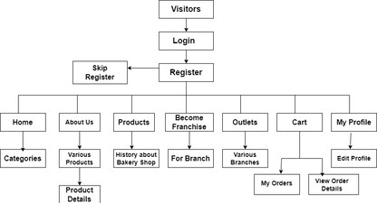
Block Diagram

Slide 4
References
https://getbootstrap.com/
https://www.w3schools.com/
https://www.djangoproject.com/

Slide 5

Thank You

